Slide 1
Pizza Restaurant Location
A Beginners data science study

Slide 2
Introduction
Overall goal is to give the new restaurant the best chance of succeeding in the competitive metro-Detroit area.
Best location to open a pizza restaurant based on:
Location
Low number of pizza places nearby
Rating
Other venues in the area should have high ratings

Slide 3

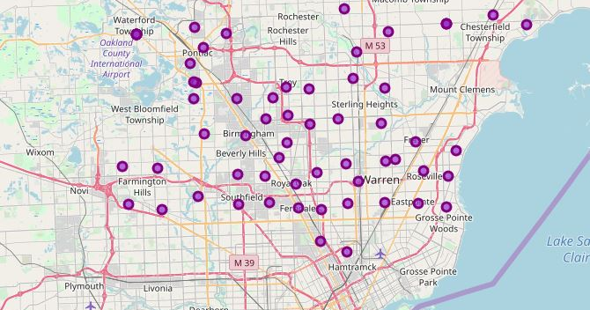
Area of Study
North/Northwest suburbs of Detroit, Michigan.

Slide 4
Data
Foursquare API
Used to find venue:
Location
Name
ID number
Category
Rating
Websites used:
Suburb names
https://guides.lib.umich.edu/c.php?g=283069&p=1885993
County of suburb
https://en.wikipedia.org/wiki/List_of_cities,_villages,_and_townships_in_Michigan
Suburb latitude/longitude (csv file)
https://www.aggdata.com/free/united-states-zip-codes

Slide 5
Methodology
Websites were scraped using BeautifulSoup to create a DataFrame that included suburb name, county, zip code, latitude, and longitude.
Folium was used for preliminary data visualization.
Foursquare API was used to get venues for each zip code with a limit of 100. All venues that had a pizza place in the top 10 most common venues were removed.
The mean venue rating was found for each zip code.

Slide 6
Results
Zip Code | Suburb | Rating
48203 | Highland Park | 8.00
48220 | Ferndale | 7.63
48315 | Utica | 7.50
48084 | Troy | 7.42
48037 | Southfield | 7.33
48397 | Warren | 7.00
48090 | Warren | 7.00
48009 | Birmingham | 7.00
48099 | Troy | 7.00
48318 | Utica | 7.00
48311 | Sterling Heights | 7.00
48331 | Farmington | 7.00
48034 | Southfield | 7.00
48314 | Sterling Heights | 7.00
48071 | Madison Heights | 6.93
48051 | New Baltimore | 6.80
48212 | Hamtramck | 6.75
48007 | Troy | 6.70
48301 | Bloomfield Hills | 6.60
48303 | Bloomfield Hills | 6.42
48086 | Southfield | 6.42
48321 | Auburn Hills | 6.42
48068 | Royal Oak | 6.42
48332 | Farmington | 6.42
48333 | Farmington | 6.42
48343 | Pontiac | 6.42
48336 | Farmington | 6.33
48237 | Oak Park | 6.00
48326 | Auburn Hills | 6.00
48335 | Farmington | 6.00
48310 | Sterling Heights | 5.75
Mean venue rating by zip code order by highest rated to lowest.

Slide 7
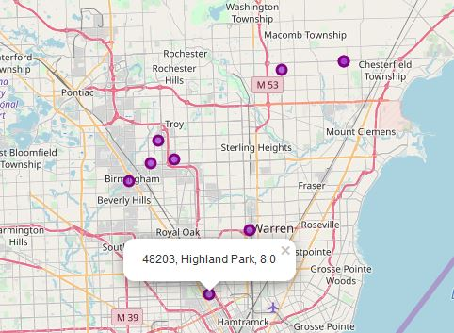
Map of Highest Rated Suburbs
Mean taken of all venue ratings for each area.

Slide 8
Discussion
Best individual suburb to open a pizza place in the north/northwest metro Detroit area would be in Highland Park, specifically zip code 48023.
No pizza place in ten most common venues
Highest mean rating
Large number of nicer venues
Both Troy and Sterling Heights come up three times on results list.
Troy overall mean: 7.04
Sterling Heights overall mean: 6.58
Large suburbs that are located directly next to one another

Slide 9
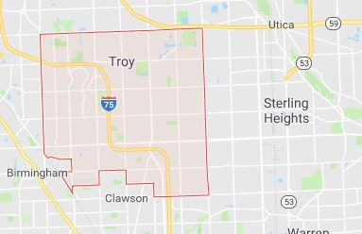
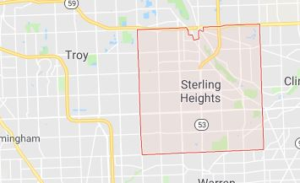
Map of Troy and Sterling Heights

Slide 10
Recommendation
Open a new pizza restaurant in Troy.
Multiple Troy zip codes have a small quantity of pizza places.
Large area means more customers.
Acceptable mean venue rating in the area.
Neighbor of Sterling Heights
Also a suburb with multiple zip codes that do not have a large quantity of pizza places.
A pizza restaurant in Troy could potentially draw in many pizza wanting customers from this suburb as well.

Slide 11
Conclusion
When opening a pizza restaurant, one needs to be very selective.
Metro Detroit is a very competitive area with many dining choices.
Through looking at the aspects of location and competing pizza restaurants, the average rating of other venues, and the ability to draw in a large customer base it is thought that a new pizza restaurant in the Detroit suburb of Troy would have the greatest chance of success.

